Slide 1





















Why Affiliate Marketing?
Word-Of-Mouth Advertisement is the most powerful mode of marketing.
Almost every company offers Affiliate program today.
And many more…

Slide 2
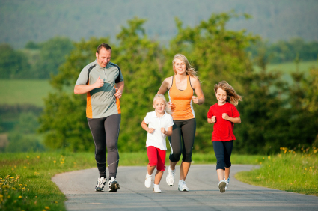
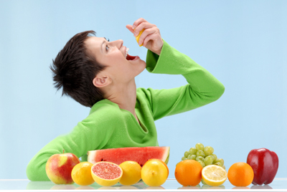
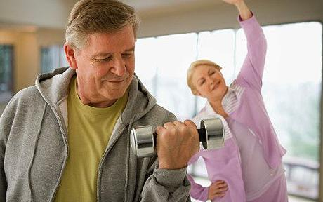
HEALTHY
WEALTHY
WISE

Slide 3
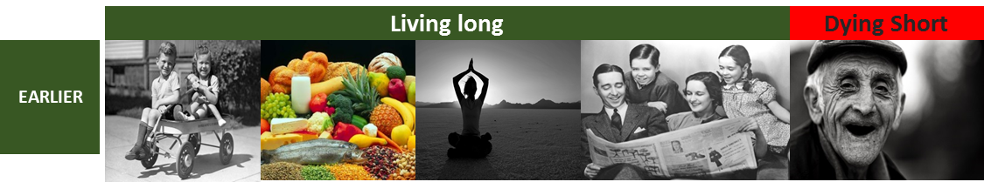

Life few decades back and today….

Slide 4
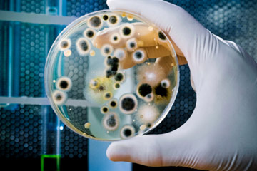
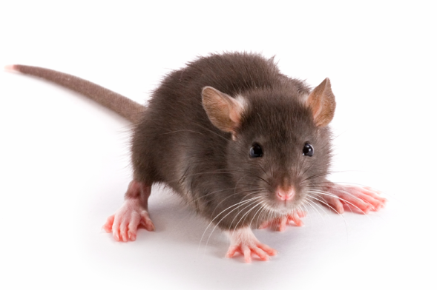
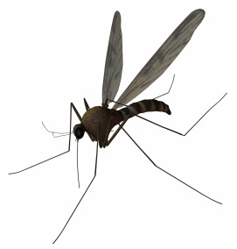
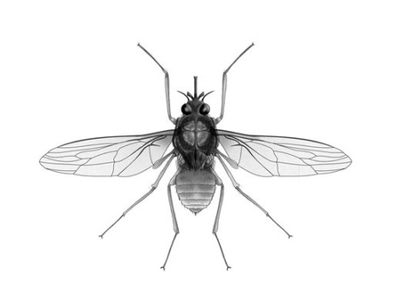
Common Health Concerns
PAST
MALARIA
TUBERCOLOSIS
WHOOPING COUGH
DIPHTHERIA
SMALL POX / CHICKEN POX
PLAGUE
FLU
CHOLERA
PRESENT
CARDIO VASCULAR DISEASE
CANCER
DIABETES
HYPERTENSION
OSTEOPOROSIS
ALZHEIMERS
STROKE
ASTHMA
OBESITY
ARTHRITIS
Cause : Micro organisms
Cause : Lifestyle – The Way we live

Slide 5
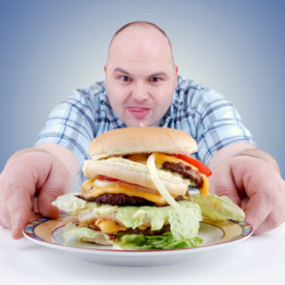
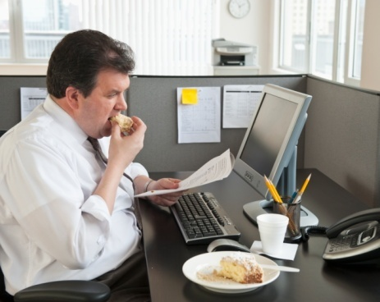

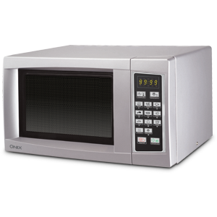
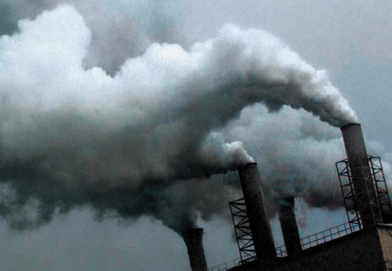

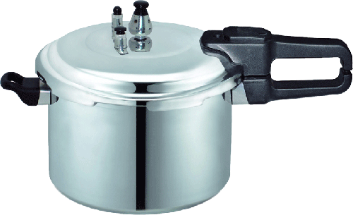
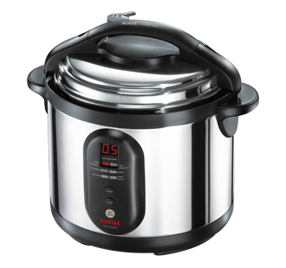
Why are we not HEALTHY ?
Poor eating habits (Junk foods)
Sedentary Lifestyle
High Stress levels
Pollution
Modern Cooking Methods
High Radiation levels

Slide 6
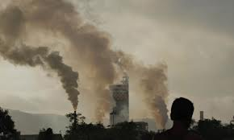
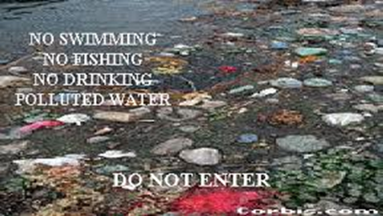
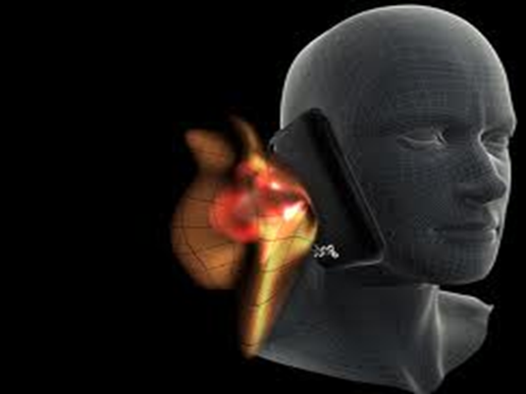
TOXINS FROM ENVIRONMENT
AIR POLLUTION
Air pollution is thought to be the cause for 1 in 10 deaths due to Lung Cancer
Environmental pollution threatens human health. Air pollution in cities causes a shorter lifespan for city dwellers.
WATER POLLUTION
Studies show that the alarming rate of increase in water pollution has affected millions of lives. More than 780 million people do not have access to clean water.
RADIATION
Radiation breaks down water in living cells into dangerously reactive free radicals which subject our bodies to a continual assault, attacking essential molecules of life such as DNA
and proteins.

Slide 7
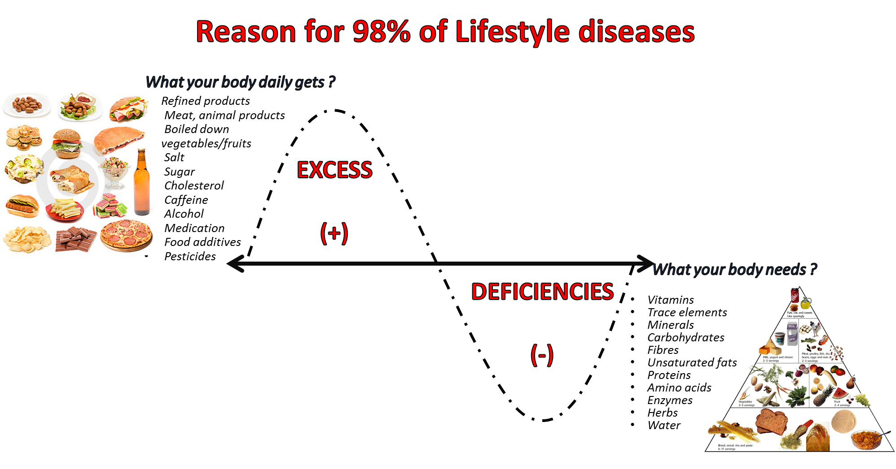
WHAT WENT WRONG ?
Earlier the food what we ate was as good as Medicine But, Today the food what we eat is as good as Slow poison.

Slide 8
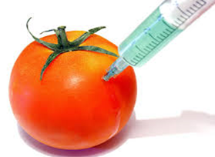
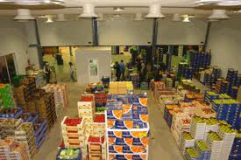
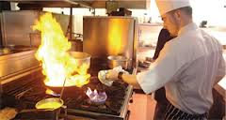
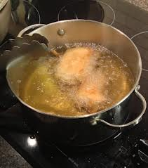
Demand Vs Supply is low - LACK OF NUTRIENTS
Your body don’t get the right nutrients from today’s diet ;
Low Nutrient levels in soil
Genetically modified crops
Toxic pesticides from GM food crops found in unborn babies. Toxic pesticides which are implanted into genetically modified food crops have lodged in the blood of pregnant women and their unborn babies, research shows. - (Times of India)
Storage & Transport
Fruit and vegetables travel thousands of miles to reach supermarkets.
Food that we assume is fresh and nutritious is often quite the reverse.
Ex:Spinach stored at room temperature loses between 50 and 90 percent of its vitamin C within 24 hours of being picked.
Cooking Method
Cooking veggies for a long period of time, or at a high temperature can destroy the nutrients, including those in the liquid

Slide 9
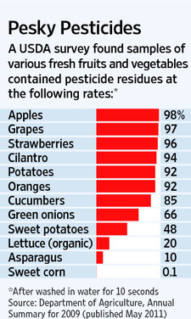
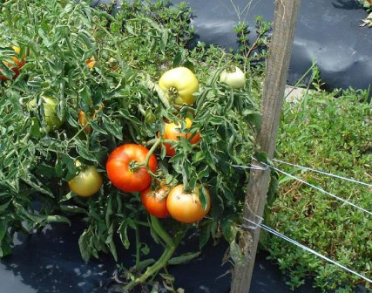
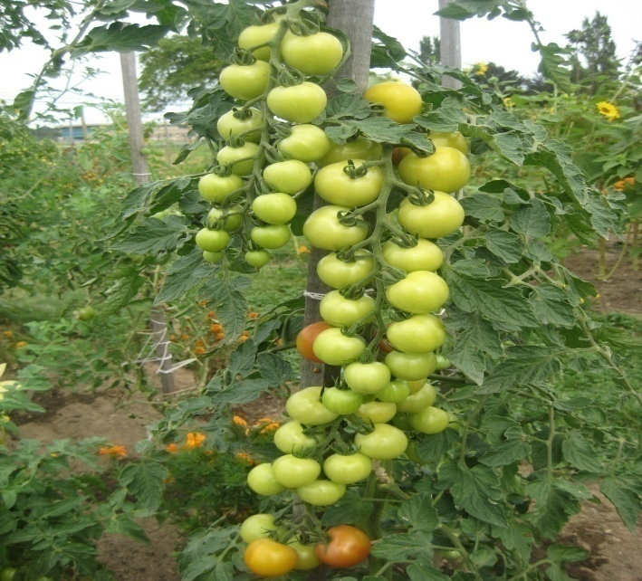
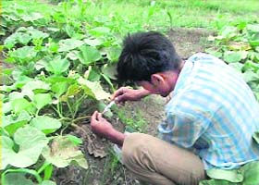
In the PAST
food was GROWN
TODAY food is MANUFACTURED
UNETHICAL PRACTICES
to increase output.

Slide 10
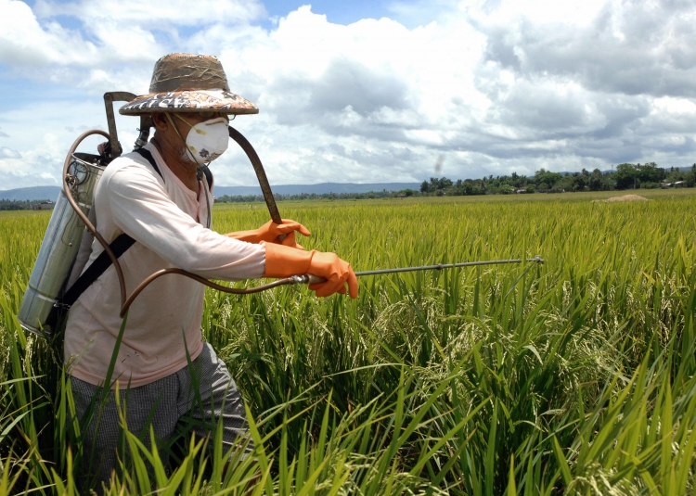
ACCUMMULATON OF TOXINS IN BODY
PESTICIDE
Chemicals in food what we eat
The World Health Organization estimates that there are 3 million
cases of pesticide poisoning each year and up to 220,000 deaths,
primarily in developing countries.
If it’s harmful to breathe, is it not harmful to eat ?

Slide 11
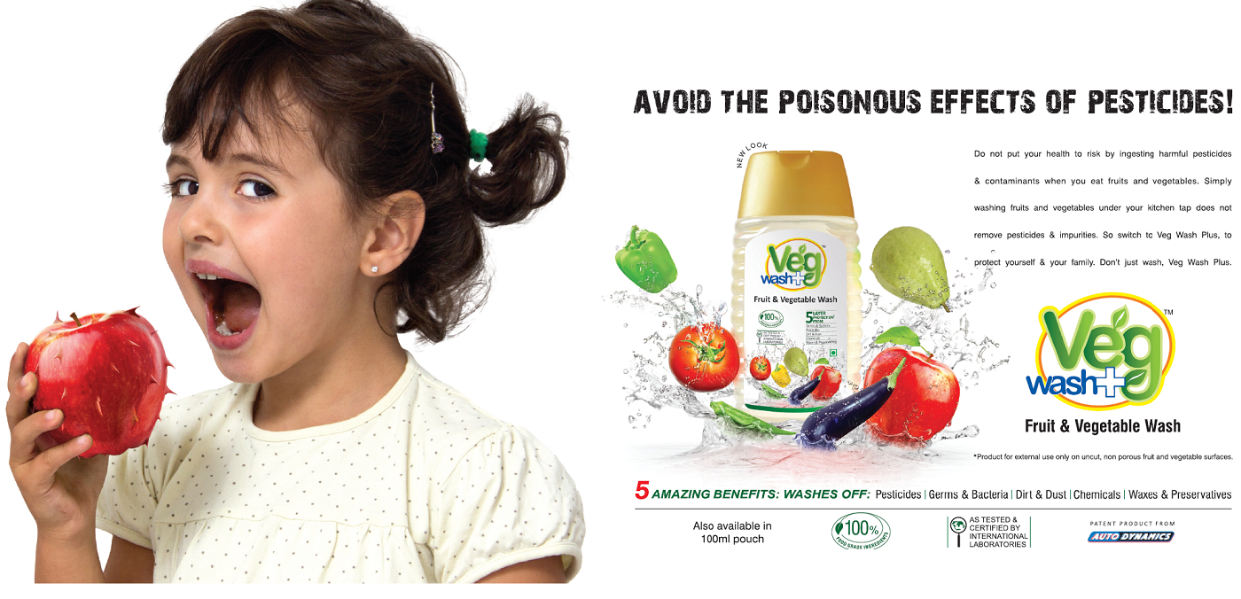

Slide 12
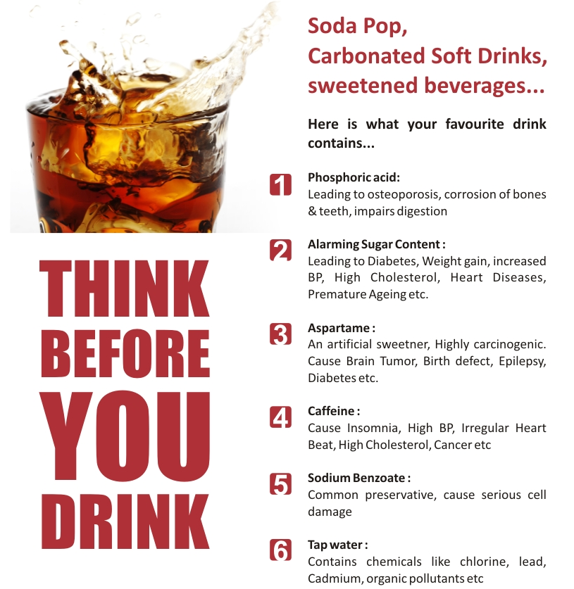
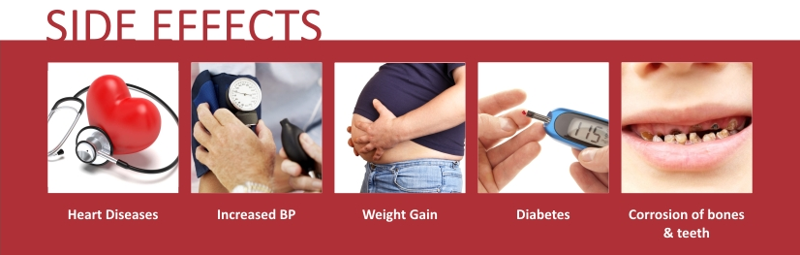
Human reports to FDA, too, have associated Aspartame to minor adverse reactions and life-threatening conditions that include:
Migraines
Change in vision
Nausea and vomiting
Insomnia / sleep problems
Abdominal and joint pains
Change in heart rate
Depression
Memory loss
Seizure
Brain cancer
You wouldn’t eat 22 packs of sugar,
why are you drinking them ?

Slide 13
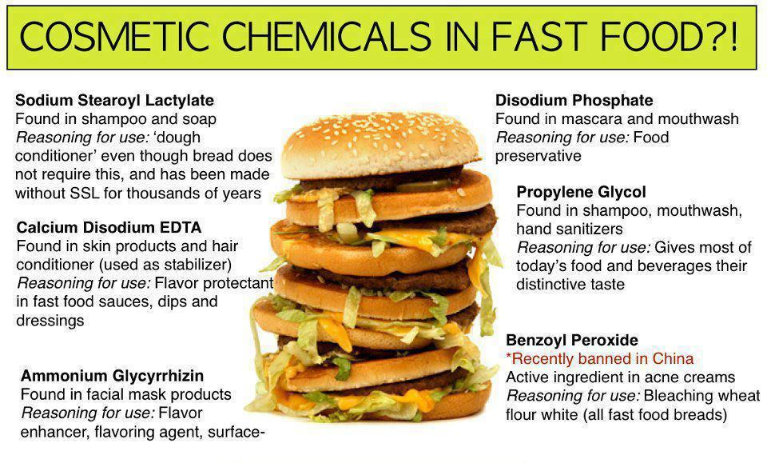
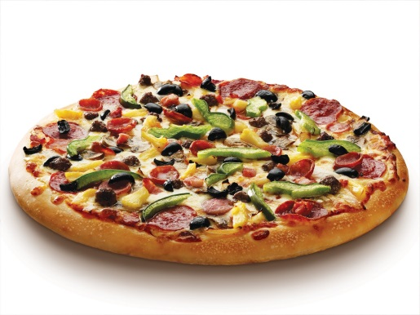
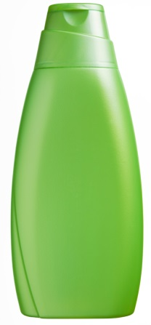
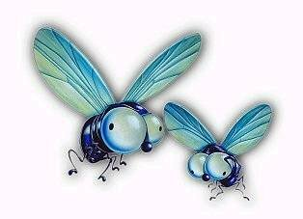

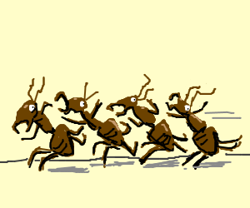
Shampoo
Now you know why flies & ants don’t come near your favourite food

Slide 14
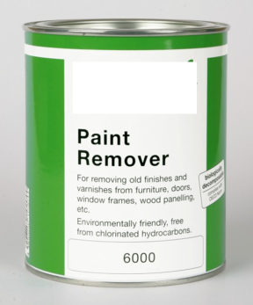
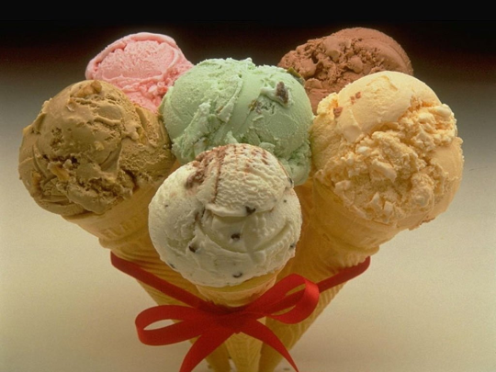
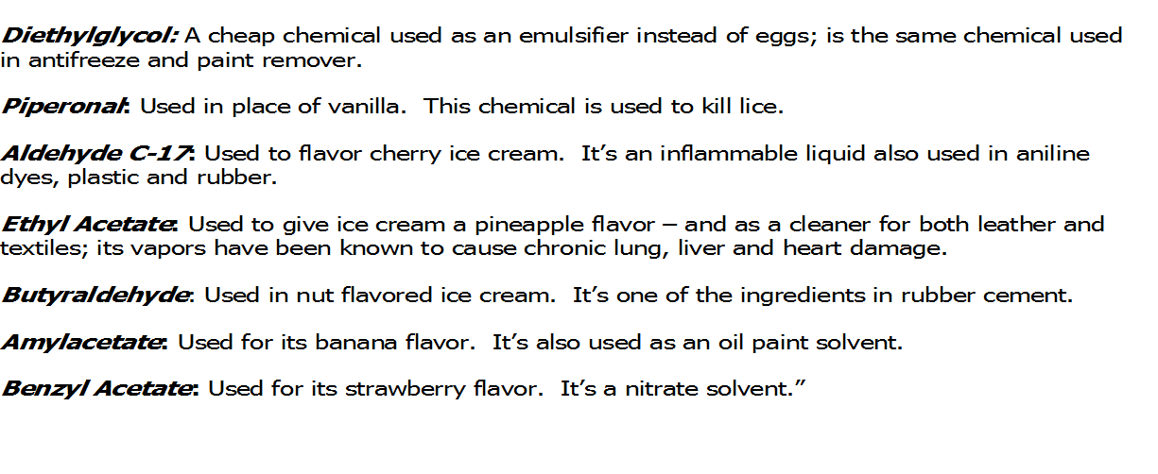

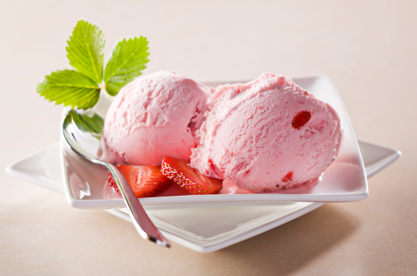
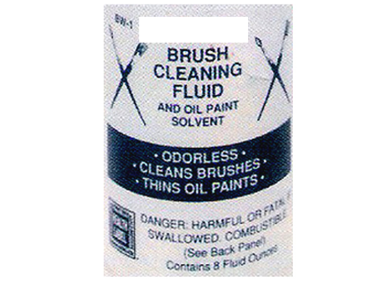

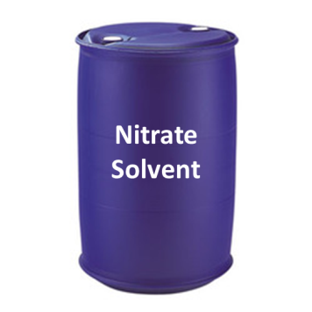
Chemicals in Ice Cream
What are these chemicals doing in the ice cream ?

Slide 15
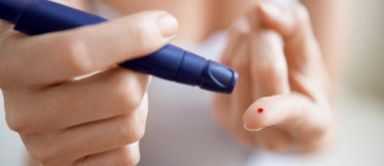
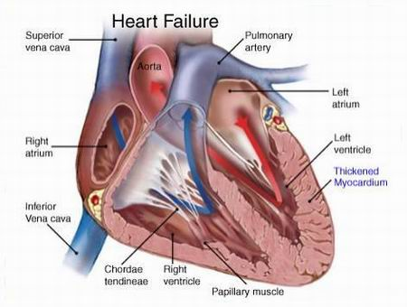
DIABETES :
1 out of 7 in India is a Diabetic
India having the highest number of diabetic patients in the world
the sugar disease is posing an enormous health problem in the country. Calling India the diabetes capital of the world.
Diabetes in India to touch 80 million by 2030
World Health Organisation
CARDIO VASCULAR DISEASES :
60% of Heart related deaths in the world will occur in India
Time Magazine
35% deaths in India due to cardiovascular diseases
Shimona Kanwar, TNN Jul 22, 2013, 03.04PM IST
Heart disease set to spike in India, especially in the south’
According to well-known radiologist Harsh Mahajan, by 2020 India will have more than 4.77 million deaths a year due to cardiovascular disease (CVD) and 2.58 million deaths due to coronary heart diseases (CHD).

Slide 16
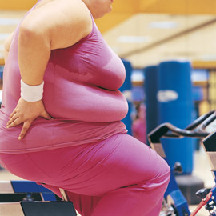

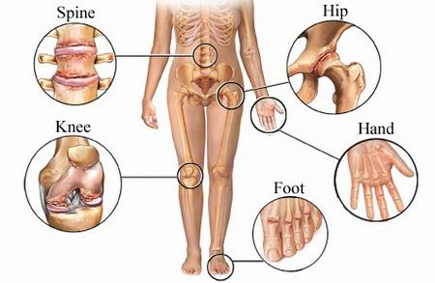
OBESITY:
Over 50% of Indian population will suffer from obesity in the coming ten years
HYPERTENSION:
35% of school children in urban areas suffer from hypertension
ARTHRITIS:
India has more people suffering from arthritis than entire
EUROPE & NORTH AMERICA combined

Slide 17
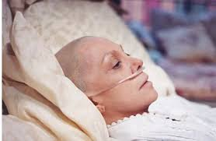
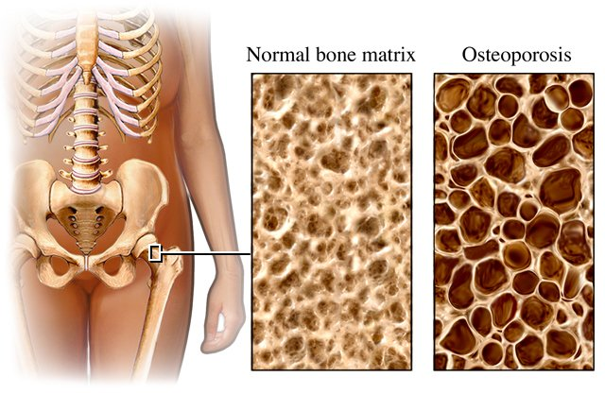
CANCER:
Cancer is the 3rd Largest Killer in India
In India, four lakhs die of cancer every year. The ministry data shows 25 lakh cancer patients in the country at any point in time. Cancer is the third biggest killer in India.
OSTEOPOROSIS:
Expected case of osteoporosis will increase by 250 million
by 2015
Based on 2001 census,approximately 163 million indians all the above age of 50,this is the expected case for osteoporosis which will increase to 250 million by 2015.
(Department of Endocrinology & Diabetes,New Delhi)

Slide 18


EARLY PUBERTY:
Puberty strikes as early at age 5 in bangalore – Times of India
Onset of puberty in girls has fallen by five years since 1920
Study: More U.S. girls starting puberty early
By Amanda Gardner, Health.com
August 10, 2010 -- Updated 0950 GMT (1750 HKT)
Girls hit puberty earlier than ever, and doctors aren't sure why
By Liz Szabo, USA TODAY
EARLY MENOPAUSE:
Menopause at age 20– Times of India
New urban scare: Menopause in 20s
Hetal Vyas TNN
'1 in 20 women' hit by early menopause: Doctors baffled at rising numbers of under-40s affected
By JENNY HOPE
UPDATED: 06:42 GMT, 7 July 2011

Slide 19

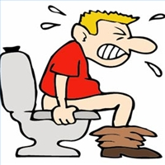
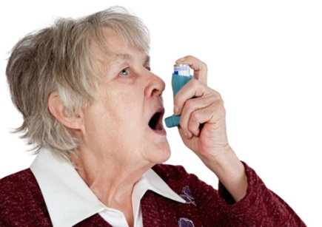


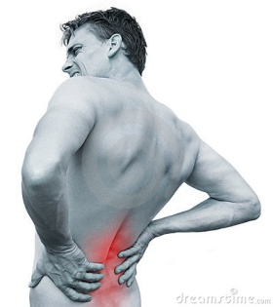









CONSEQUENCES OF LACK OF PROPER NUTRITION
LIFESTYLE DISORDERS
CONSTIPATION
ASTHMA
FASTER AGING
BACK PAINS
JOINT PAINS
INFERTILITY
OBESITY
MIGRANE
FATTY LIVER
OSTEOPOROSIS
HEART ATTACK
PARALYSIS

Slide 20
Quest for Wellness
Gym
Surgery
Drugs
Weight loss clinics
Yoga

Slide 21
APPROACH TOWARDS HEALTH
Careful approach for a vehicle you can always buy, but a Careless approach
for the Health you can never buy
“Take care of your body, It’s the only place
You have to Live” - Jim Rohn

Slide 22


How to bring back the optimal health ?
The Only Answer
is
Nutritional Supplements
Remove Toxins
by
Detoxification
OPTIMAL HEALTH
Fulfil the Nutritional
Deficiency with Dietary
Supplements

Slide 23



P
ROFILE
1988 - Sabinsa Corporation Founded in New Jersey, USA
About Us – Sami Sabinsa - HISTORY
31 Years of Research & Development in
HEALTH SCIENCE

Slide 24





Slide 25

DR. MUHAMMED MAJEED
A VISIONARY & THE ARCHITECT OF SAMI DIRECT
Obtained his degree in Pharmacy in 1973.
MS in Industrial Pharmacy from Long Island University, New York
in 1975.
PhD in Industrial Pharmacy from St John's University, New York.
Worked with Pfizer Inc, Carter-Wallace and Paco Research.

Slide 26



Slide 27


Slide 28


Slide 29



Slide 30



Slide 31

BIGGEST FARMING IN WORLD
SAMI DIRECT HAVE
TOTAL FARMING
AREA IN INDIA IS
70,000 ACRE
AND ALL OVER
WORLD IS
2,10,000 ACRE
ALL FARMINGS ARE
100% NATURAL AND
ORGANIC

Slide 32


Slide 33

SAMIDIRECT – Presenting Ayurveda in the STANDARD DOSAGE FORM
When diet is wrong, medicine is of no use.
When diet is correct, medicine is of no need.
~ Ayurvedic Proverb

Slide 34

Nutraceutical Supplements
28

Slide 35


Slide 36





Detox
According to the Royal Society of Medicine (England) more than 65% of different health problems are caused by TOXIC COLONS

Slide 37

Detox
Importance of drinking Water
2 glasses – After waking up; activate internal organs.
1 glass – Before taking bath; lowers blood pressure.
3 glasses – 1 glass 30 minutes before each meal; digestion.
1 glass – before sleep; avoid stroke or heart attack.
3 to 5 glasses – anytime thru out the day; to clean body and remove waste.
We require 1 liter of water for every 20 kgs of body weight.

Slide 38

Detox

Slide 39








Detox
Prevents
Degeneration
of the Liver
Nela Nellikai

Slide 40

Detox

Slide 41

Detox

Slide 42






General Wellness
Why do we need Food ?
ENERGY
VITAMINS
MINERALS
AMINO ACIDS
PHYTO NUTRIENTS
ANTIOXIDENTS
MACRO NUTRIENTS
MICRO NUTRIENTS
1. To give ENERGY for our CELLS during the DAY.
2. To REPAIR & REGENERATE our CELLS at NIGHT

Slide 43






Slide 44


Slide 45


FREE RADICALS (OXIDATION)
ANTI OXIDANTS with high ORAC value.

Slide 46












1,746
3,406
50,372
1,819
4,454
102,700
1,990
5,708
3,049
14,840
127,068

Slide 47

General Wellness

Slide 48

General Wellness

Slide 49








Prevents
Various Types of Cancers
Chinese cucumber,
Chikka Halasu.

Slide 50

General Wellness

Slide 51







General Wellness
2.5 Kg = 60 mg CoQ10
Provides Energy
for Vital Organs
Anyone over 40, should take at least 60 to 100 mg of CoQ10 every day.
2.5 Kg = 65 mg CoQ10

Slide 52

General Wellness

Slide 53








General Wellness
Provides all 46 essential Nutrients

